Slide 1
Software Design and Analysis CS-3004 Lecture#09
Dr. Javaria Imtiaz,
Mr. Basharat Hussain,
Mr. Majid Hussain

Slide 2
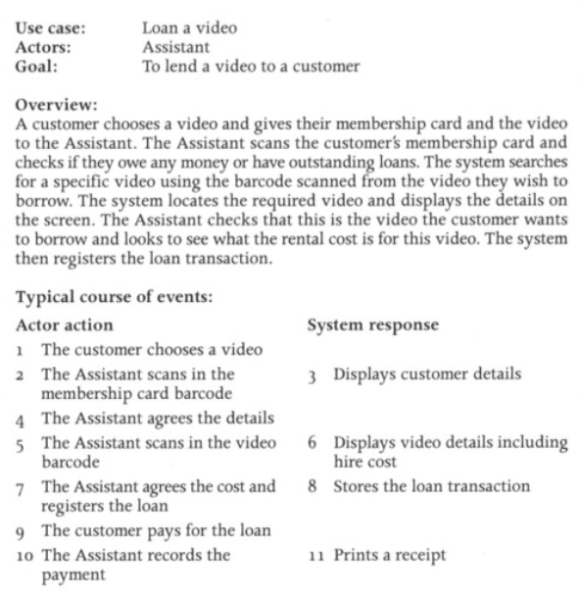
Quiz 03

Slide 3
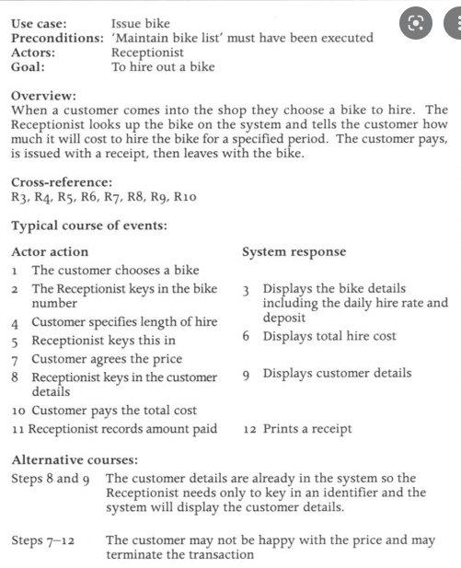

Slide 4
Revision up till now
UML Artifacts
Visual Representation
of Requirements in the form of Use Case Diagram
High-Level and Expanded Use cases
Visual Representation Domain
Visual Representation each Use Case
Set of Requirements
Use Case
Diagram
Domain Model
System Sequence Diagram
Sequence Diagram
Use case Identification
Boss test
Elementary Business Process
Size Test
Represent feature/functions/user goals
Presented as VERB
Domain Conceptual Classes
Attributes
Relationship between conceptual classes
Cardinality
System as a Blackbox
System events
System as a white box
Main Success Scenarios
Non-Functional Requirements
Functional Requirements

Slide 5
UML
Interaction Diagrams
UML Sequence Diagrams

Slide 6
Sequence Diagram
Sequence diagram simply depicts interaction between objects in a sequential order (i.e. the order in which these interactions take place.)
Sequence diagrams describe how and in what order the objects in a system function

Slide 7
Sequence Diagram
They illustrate how the different parts of a system interact with each other to carry out a function, and the order in which the interactions occur when a particular use case is executed

Slide 8
Interaction diagrams are used to visualize the interaction via messages between objects; they are used for dynamic object modeling.
3

Slide 9
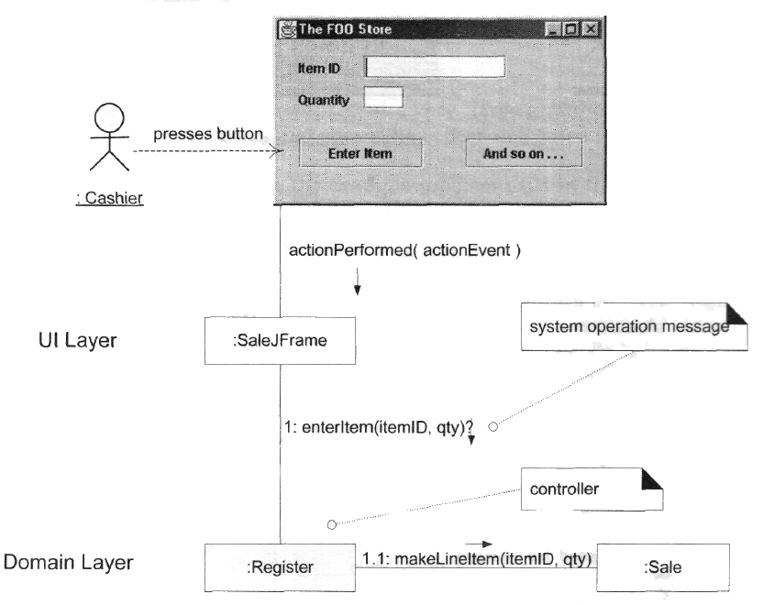
Example

Slide 10
Example of Sequence Diagram
:A
myB:B
do1
do2
do3

Slide 11
Java Code for Interaction Diagrams
7
:A
myB:B
do1
do2
do3
E x a m p l e
public class A { private B myB = ...;
public void do1() { myB.do2();
myB.do3();
}
}
Sequence Diagram

Slide 12
Common Notations for UML Interaction Diagrams
:Sale
Lifeline box representing an unnamed instance of class Sale.

Slide 13
Common Notations for UML Interaction Diagrams
s1:Sale
Java Code:
Sale s1 = …;
Lifeline box representing a named instance (s1) of Sale.

Slide 14

Common Notations for UML Interaction Diagrams
sales:ArrayList<Sale>
Java Code:
ArrayList<Sale> sales = …;
Lifeline box representing an instance of an ArrayList class, parameterized to hold Sale objects.

Slide 15
Common Notations for UML Interaction Diagrams
sales[i]:Sale
Java Code:
ArrayList<Sale> sales = …; Sale sale = sales.get(i);
Lifeline box representing one instance of class Sale, selected from the sales ArrayList<Sale> collection.

Slide 16
Common Notations for UML Interaction Diagrams
:Sale
s1:Sale
sales:ArrayList<Sale>
sales[i]:Sale

Slide 17
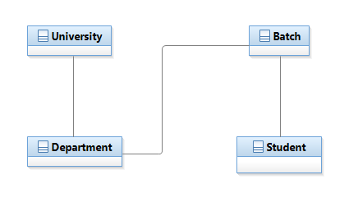
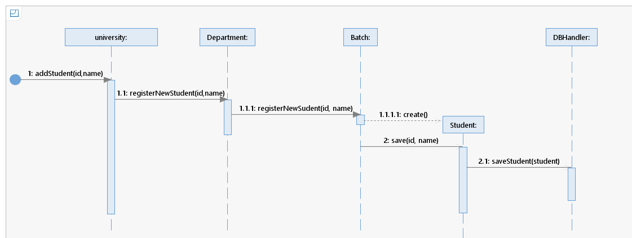
Sequence Diagram Example

Slide 18

Common Notations for UML Interaction Diagrams - Format for Interaction Messages
“Commonly” Used Grammar:
return = message(parameter:parameterType):returnType
Parentheses are usually excluded if there are no parameters. Type information may be excluded if unimportant.
initialize(code) initialize
d = getProductDescription (id)
d | = | getProductDescription | (id : | ItemId)
d | = | getProductDescription | (id : | ItemId) : | ProductDescription
The same syntax is used by, e.g., the Scala programming language.

Slide 19
UML Sequence Diagrams

Slide 20
Modeling (Synchronous) Messages
^{UML Sequence Diagrams} | ₁₈
a found message whose sender will not be specified
typical synchronous message shown with a filled-arrow line
:Register
:Sale
Report()
getDate()
execution specification bar indicates focus of control
toString()
getRegNo()
Notes:
Synchronous messaging can be best understood as a live one-to-one conversation

Slide 21
Self messages can be modeled using nested execution specification bars.
^{UML Sequence Diagrams |} 20
:Register
self message
cancelTransaction
log

Slide 22


To show the return value of a message you can either use the message syntax (A) or use a message line at the end of an execution specification bar (B).
:Register
:Sale
report
theReport = report
V a r i a n t A
:Register
:Sale
report
report
theReport
V a r i a n t B

Slide 23
Object Instance Creation
:Register
:Sale
Newly created objects are placed at their creation “height”.
makePayment(cashTendered)
create(cashTendered)
:Payment
authorize
The name create is an UML idiom; it is not required.

Slide 24

Object Instance Destruction
:Register
:Sale
makePayment(cashTendered)
create(cashTendered)
:Payment
...
X
Not strictly required by the UML.
The object destruction notation is also used to mark objects that are no longer usable.

Slide 25




Invoking Static Methods (Class Methods)
:Register
Calendar
report
locales = getAvailableLocales
public class Register { public void report() {
Locale[] locales = Calendar.getAvailableLocales();
}
}
Corresponding Java Code

Slide 26




Diagram frames in UML sequence diagrams are used to support - among others - conditional and looping constructs.
:Cashier
:System
loop
[more items]
enterItem(itemId, quantity)
description, price, total

Slide 27


How to model the iteration over a collection?
Modeling task: Calculate the total of a sale by summing up the sub totals for each sales line item.

Slide 28


Use a UML loop frame to iterate over a collection.
lineItems[i] : SalesLineItem
:Sale
t = getTotal
loop
[0 < i < lineItems.size]
st = getSubTotal
i++
Modeling task: Calculate the total of a sale by summing up the sub totals for each sales line item.

Slide 29
Use a UML loop frame to iterate over a collection.
^{UML Sequence Diagrams} | ₂₉
:Sale
lineItems[i] : SalesLineItem
t = getTotal
loop
[for each sales line item]
st = getSubTotal
Modeling task: Calculate the total of a sale by summing up the sub totals for each sales line item.

Slide 30

Java code corresponding to a UML loop frame.
^{UML Sequence Diagrams} | ₃₀
:Sale
lineItems[i] : SalesLineItem
public class Sale {
t = getTotal
private List<SalesLineItem> lineItems
= new ArrayList<SalesLineItem>();
loop
[for each sales line item]
st = getSubTotal
public Money getTotal() { Money t = new Money(); Money st = null;
for (SalesLineItem lineItem : lineItems) { st = lineItem.getSubtotal();
t.add(st);
}
return t;
}
}

Slide 31
How to model the sending of a message only if a guard condition matches?
^{UML Sequence Diagrams |} 31
Modeling task: Get the sum of all sales that happened today after 18:00 o’clock.

Slide 32
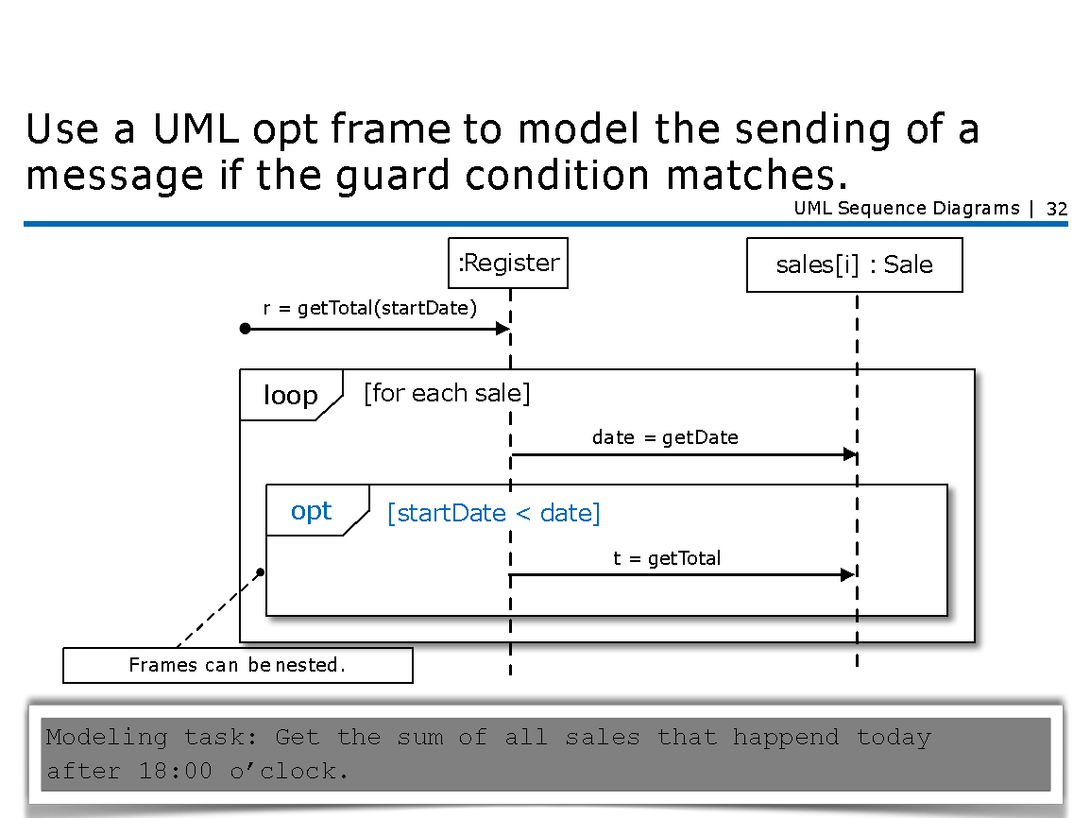




Use a UML opt frame to model the sending of a message if the guard condition matches.
^{UML Sequence Diagrams |} 32
:Register
sales[i] : Sale
r = getTotal(startDate)
loop
[for each sale]
date = getDate
opt
[startDate < date]
t = getTotal
Frames can be nested.
Modeling task: Get the sum of all sales that happend today after 18:00 o’clock.

Slide 33
How to model mutually exclusive alternatives?
^{UML Sequence Diagrams |} 33
Modeling task: A register should be able to handle credit card payments and cash payments.

Slide 34



Use the UML alt frame to model between 2 and n mutually exclusive alternatives.
^{UML Sequence Diagrams |} 34
:Register
makePayment(type,sale)
alt
[type = CreditCardPayment]
create
:CreditCardPayment
[type = CashPayment]
create
:CashPayment
Modeling task: A register should be able to handle credit card payments and cash payments.

Slide 35
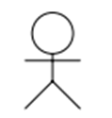
Process Sale Scenario
: Cashier
:System
makeNewSale ()
loop
[ more items ]
enterItem(itemID, quantity)
makeNewSale()
enterItem(itemID, quantity)
endSale()
makePayment(amount)
description, price, total
endSale
total with taxes
makePayment(amount)
change due, receipt

Slide 36
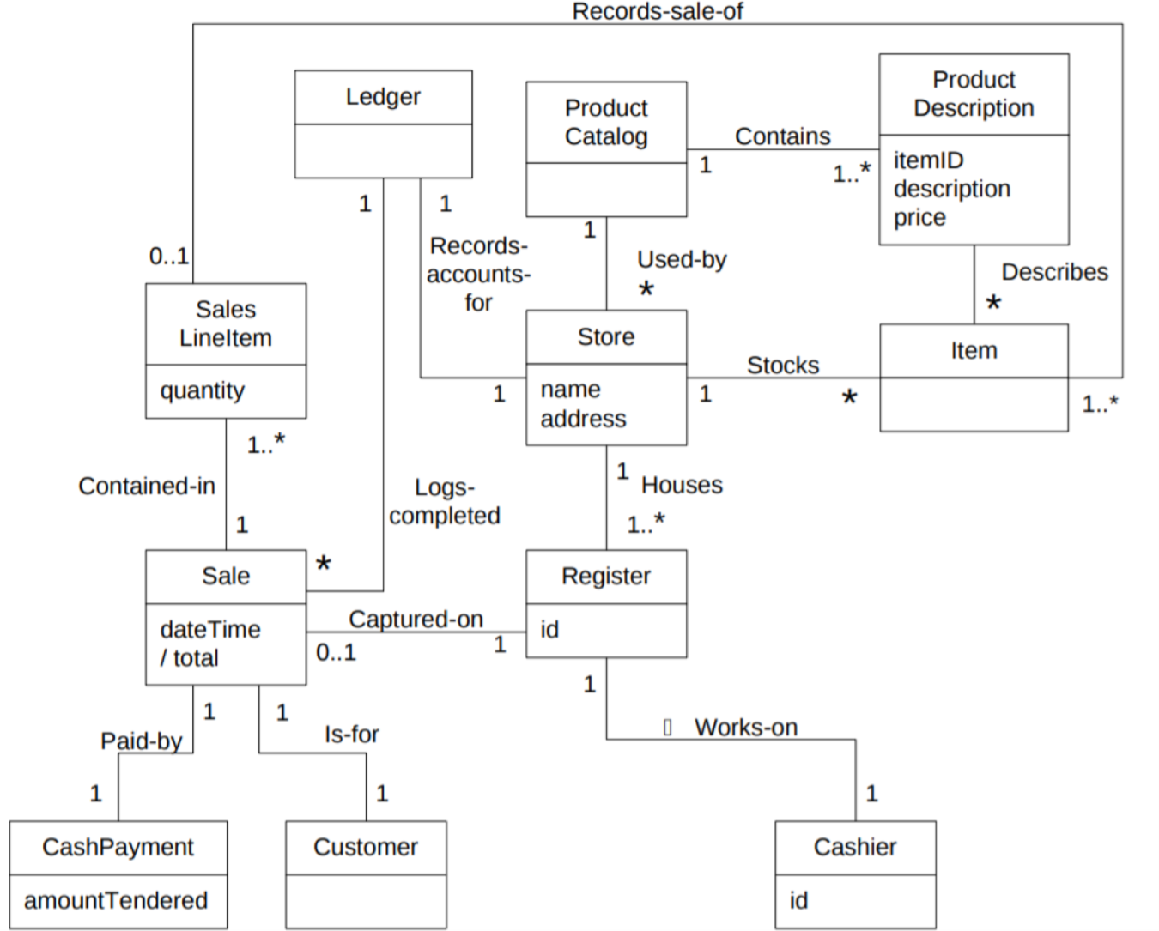
Domain Model

Slide 37
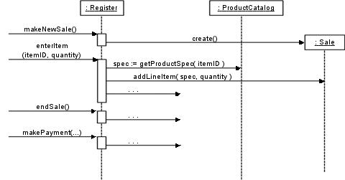
Process Sale

Slide 38
The goal of this lecture is to enable you to systematically carry out small(er) software projects that produce quality software.
Summary
Modeling the dynamic behavior is often more rewarding than modeling the static structure w.r.t. understanding a domain
Modeling the dynamic behavior is often particularly useful if the control-flow is more involved; but only draw the part that is relevant to understand the problem at hand
The UML is often used informally - this is OK if everyone interprets the diagrams in the same way

